Slide 1
Developing APIs in ColdFusion
Nick Kwiatkowski
Hawaii ColdFusion User’s Group
1/20/2023

Slide 2
Welcome!
Slides, examples and docker images can be found at :
https://github.com/quetwo/hawaii-apis
Take a look at the README for instructions on getting started. You have a few minutes while we talk about the basics.
This presentation assumes you have a passing knowledge of CFCs and basic CFML. We will be using the Lucee engine and MySQL for our demos, but Adobe CF (version 9.1 and later) and other SQL engines will be nearly identical.
This meeting will be recorded.

Slide 3
About Nick
CF programmer since the mid 90’s – started with CF 4.0.1
Member of the Apache Foundation, and a committer to a few projects
MMCFUG member and contributor
Adjunct Professor at Michigan State University in the College of Communication Arts and Sciences
Manager of the Unified Communications Team at Michigan State University

Slide 4
APIs

Slide 5
APIs
APIs (Application Programming Interfaces) are a way to allow application-to-application transmission of data.
Typically designed as programmer interfaces between programs and services
Not necessary human readable consumption – not uncommon for requests and responses to come in binary, XML, or other formats.
Used by practically every org and service out there to transmit data between orgs and within orgs.

Slide 6
APIs
APIs usually are exposed via ‘constitutions’ or agreements between the provider and the client
The provider of the data would set some sort of expectation on how the client would obtain that data. This could be through documentation or some sort of discovery service.
The expectation would then be that the client would request that data in the manner that the service is expecting.
The expectation would then be that the provider would return the data in the way that the client is expecting.
Typically, the data would be returned in a formatted, computer parseable way that the application developer would be able to do something with.

Slide 7
APIs
These days, most APIs on the internet are exposed as REST endpoints
More on what these are in a moment.
Other common ways to exchange data over the internet would be Web Services/SOAP, GraphQL, binary formats (like DS), raw HTTP, WebRTC/WebSockets, email, FTP, etc.
APIs exist a lot more than just on the web. Operating systems, programming languages, devices, etc. all rely on common API sets to allow programmers to exchange data and plug in functionality.

Slide 8
What is REST?

Slide 9
What is REST
REST = Representational State Transfer
Using the metadata of an HTTP call to convey data and select interfaces.
Used for machine-to-machine data transfers in a normalized way.
Unlike SOAP, RPC and other communication methods, there is no ‘official’ standard to follow or RFC to define how it is designed to work. It’s just the thought of using the existing protocols.
Generally used to expose APIs from your applications to either be consumed by your site or to express data to others.

Slide 10
METHOD = GET
Headers : ACCEPT : text/html Authentication-token : Bearer : abc:123
http://server/application/endpoint/

Slide 11
Consuming REST endpoints in CFML

Slide 12
Consuming REST endpoints in CFML
Consuming REST endpoints from other servers or services usually involves an HTTP call
Turns out, we have <cfhttp> !
Every REST endpoint is slightly different, so you will need to do some sleuthing on how to get them to work
I usually use POSTman to get a working call first, then implement what I learned there to build my code.
Things to pay attention to:
Accept, Auth Tokens, Required headers, form or raw data, etc.

Slide 13
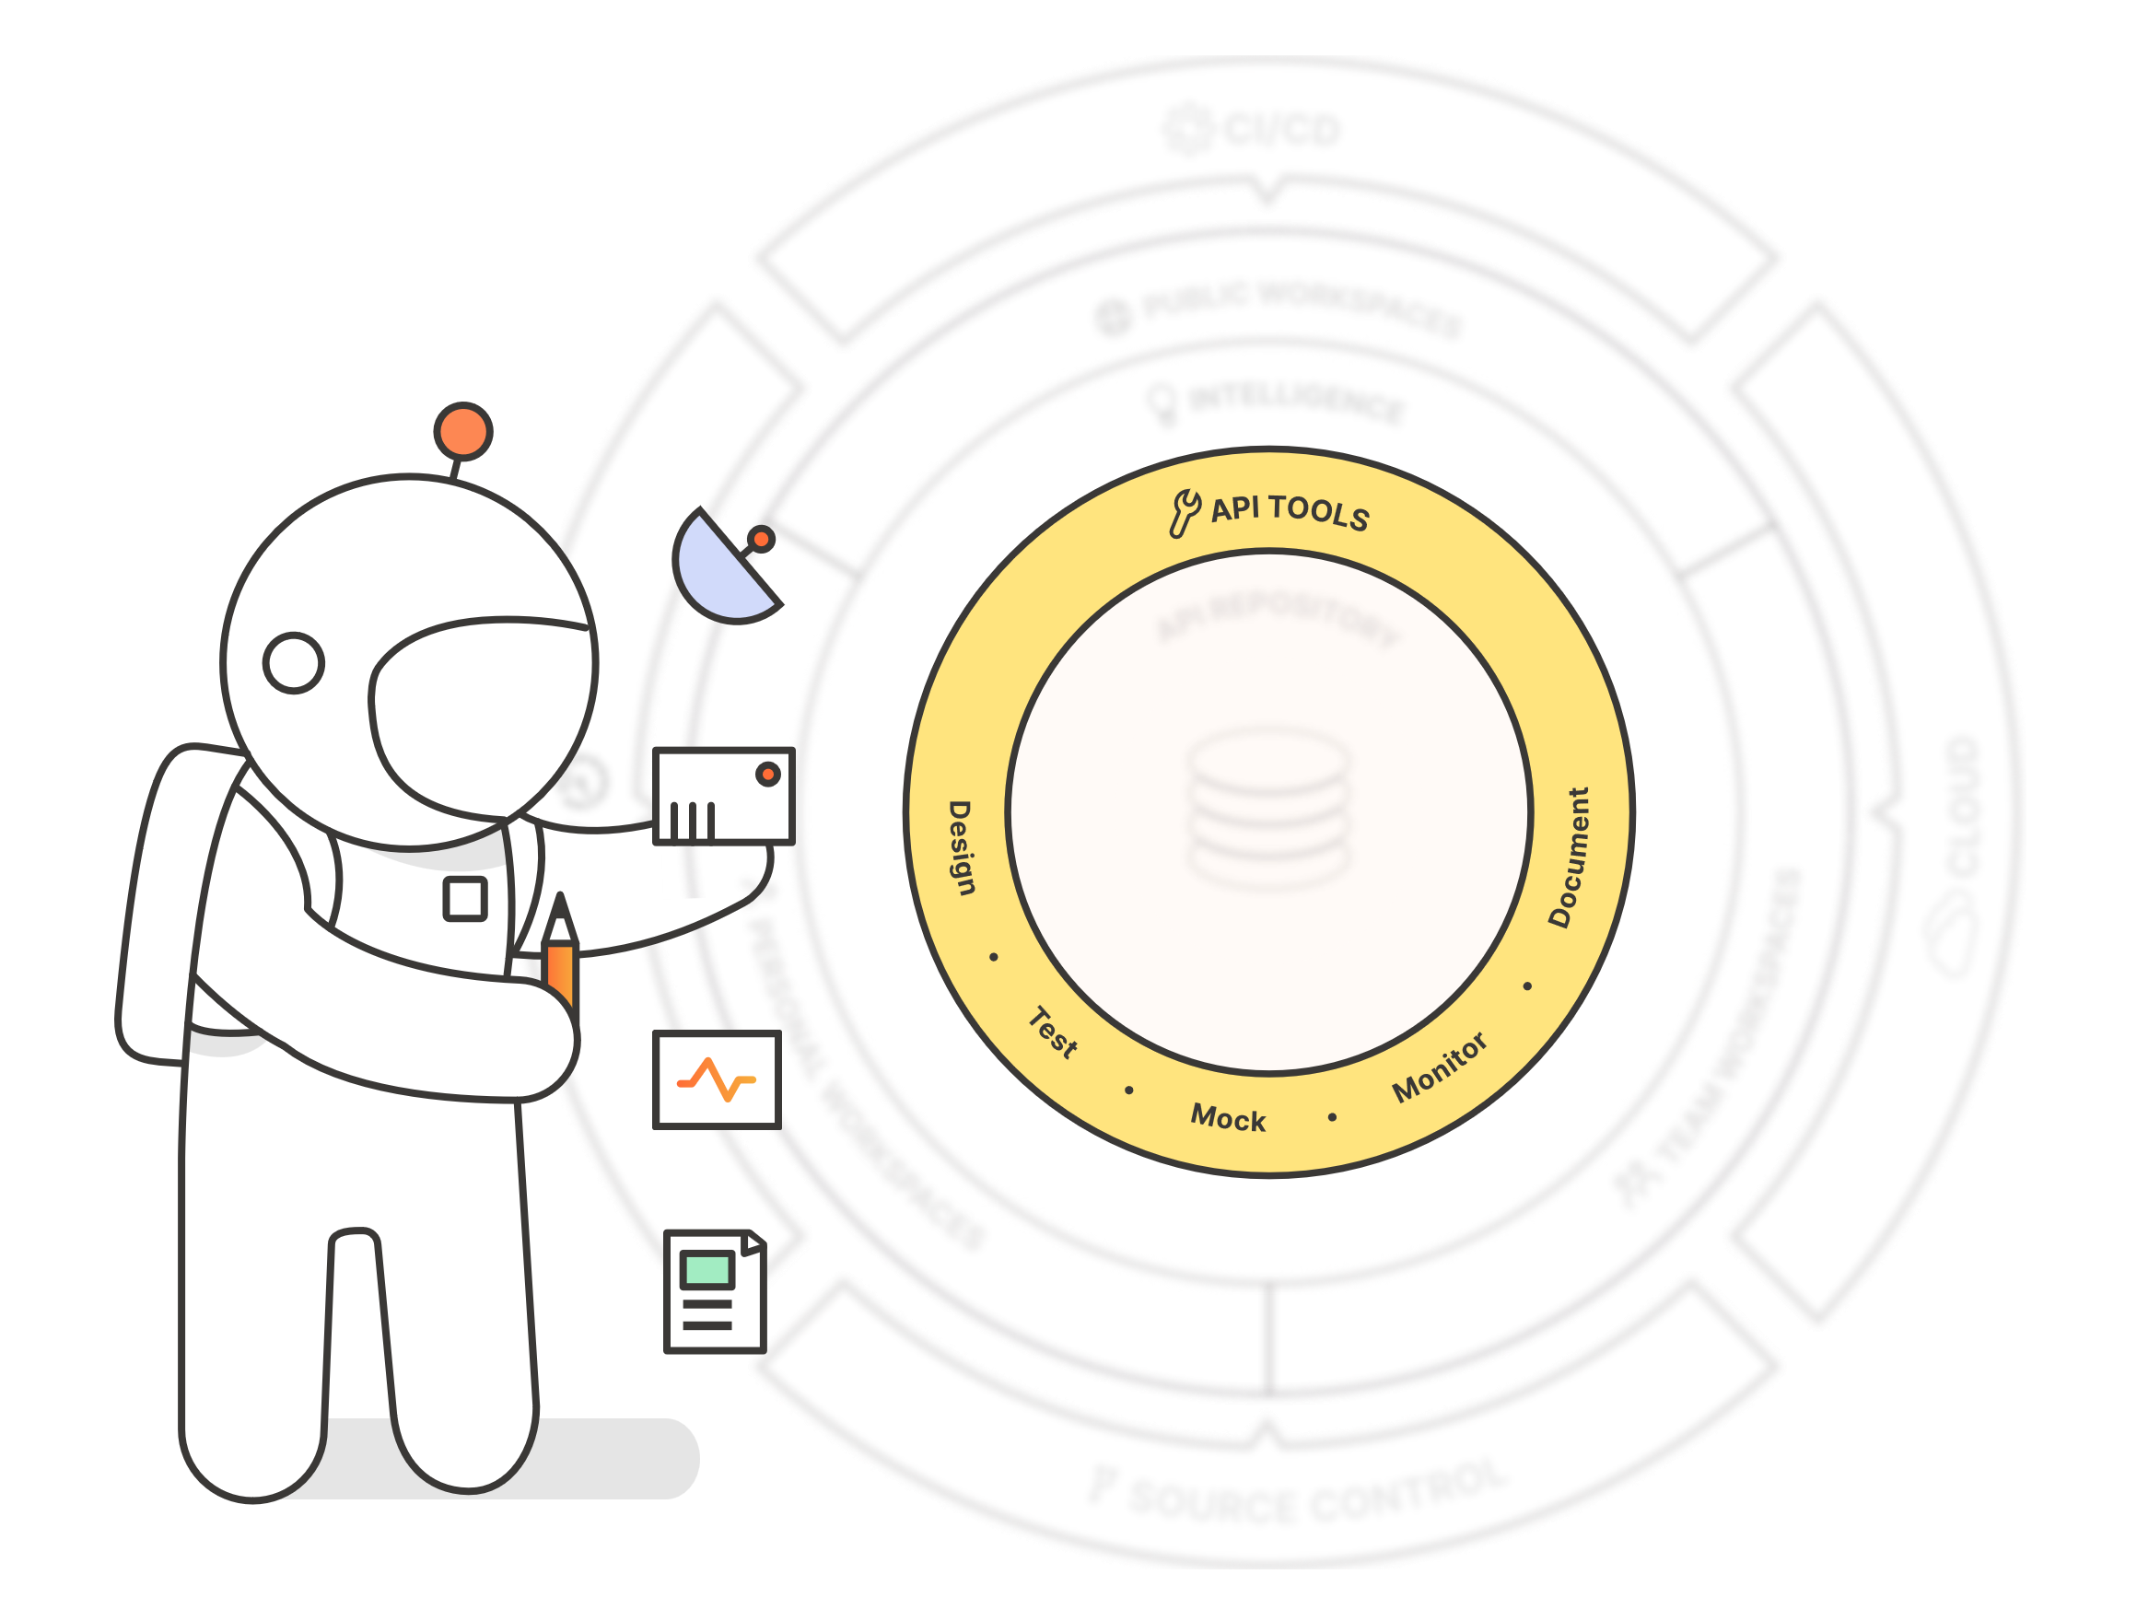
Postman
Before we dive into creating REST API endpoints, lets explore one of the more popular tools for debugging and working with REST APIs
www.postman.com
Started as a Chrome plugin, and has since grown to a full API development and documentation service
Postman tool is still free, other tools can cost $$

Slide 14
Consuming REST endpoints in CFML
https://localhost/demo0/

Slide 15
Building REST endpoints in CFML

Slide 16
REST
In the ColdFusion world, there are a few ways to create these API endpoints :
Creating REST CFCs in ACF/Lucee to process data.
Raw functionality. You will need to own your own auth, rate limiting, etc.
Using a framework like Taffy.io to develop your APIs
Adds a ton of features using code.
Using the Adobe ColdFusion API Manager
Bolt-on product from Adobe that helps implement a ton of features using a Web UI
Gives access to authentication, analytics, rate limiting, auto-documentation, etc.

Slide 17
REST
In the ColdFusion world, there are a few ways to create these API endpoints :
Creating REST CFCs in ACF/Lucee to process data.
Raw functionality. You will need to own your own auth, rate limiting, etc.
Using a framework like Taffy.io to develop your APIs
Adds a ton of features using code.
Using the Adobe ColdFusion API Manager
Bolt-on product from Adobe that helps implement a ton of features using a Web UI
Gives access to authentication, analytics, rate limiting, auto-documentation, etc.

Slide 18
REST
Exploring what REST communications look like :
https://localhost/demo1/

Slide 19
Exploring Postman

Slide 20
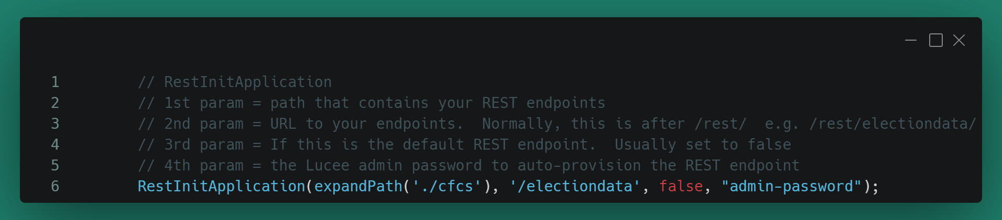
REST Configuration
There are a few things you will need to do in order to begin working on REST endpoints
Create an application mapping. Done via the administration panel of your server /or/ via code.
Maps a REST URL to an ‘application’ running on your server.
For code version, REST endpoints won’t be available until the RestInitApplication line runs.

Slide 21
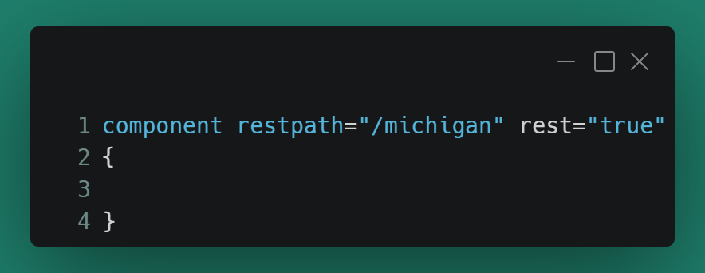
REST Configuration
There are a few things you will need to do in order to begin working on REST endpoints
Create a new CFC that identifies the endpoint “node”.
Normal CFC. Can do all the normal CFC things (inheritance, etc.)
rest = true on the component line to tell the REST manager to process it
restpath = the part AFTER the application in the URL.

Slide 22
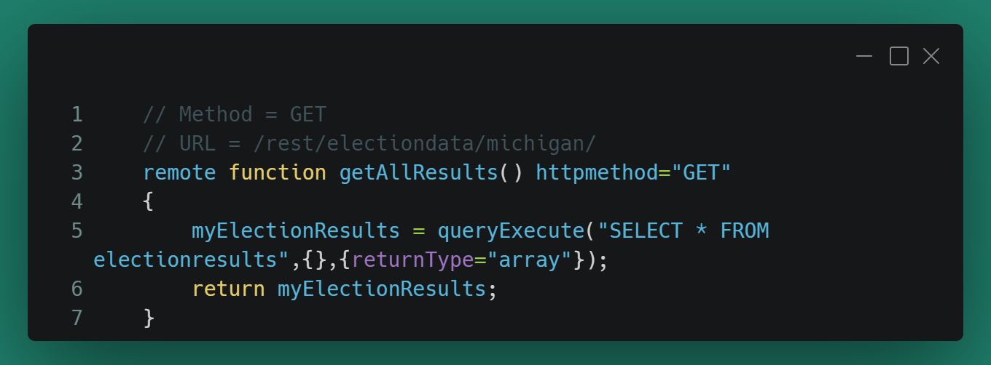
REST Configuration
There are a few things you will need to do in order to begin working on REST endpoints
Create the REST enabled functions
Generally, you will define the httpmethod for the REST endpoint and the RESTpath (if the restpath is not defined, it defaults to the node’s URL)

Slide 23
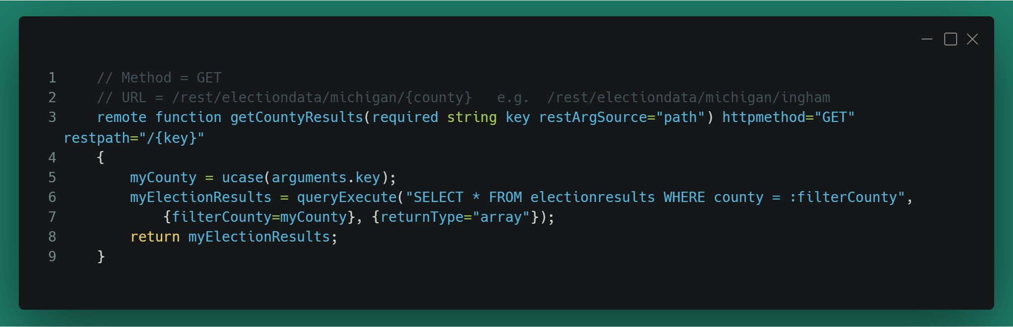
REST Endpoints – REST Paths
One common way to inject data into the stream coming from the client to the endpoint is via the URL
restpath defines the path AFTER the endpoint marker in the URL
In the arguments portion of the function definition, you can set the ‘restArgSource’ to path to tell the engine that variable is defined there.

Slide 24
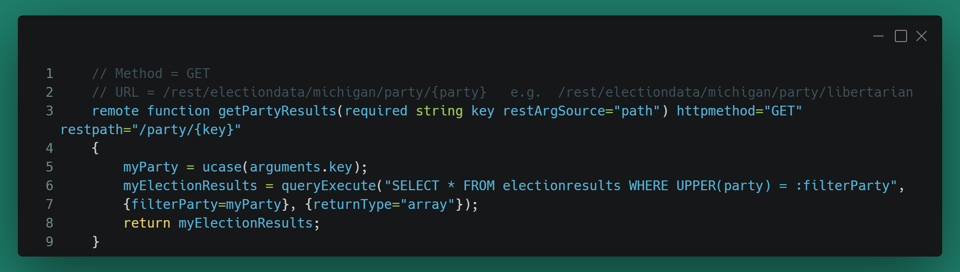
REST Endpoints – REST Paths
You don’t have to just inject the variable right after the endpoint marker.

Slide 25
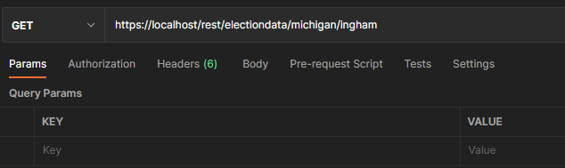
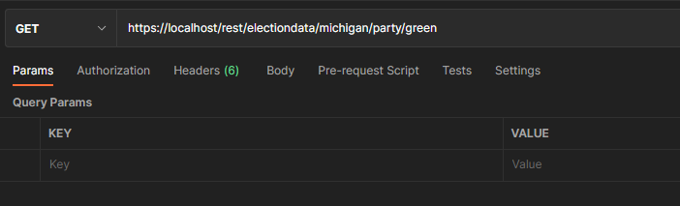
Testing endpoints in Postman

Slide 26
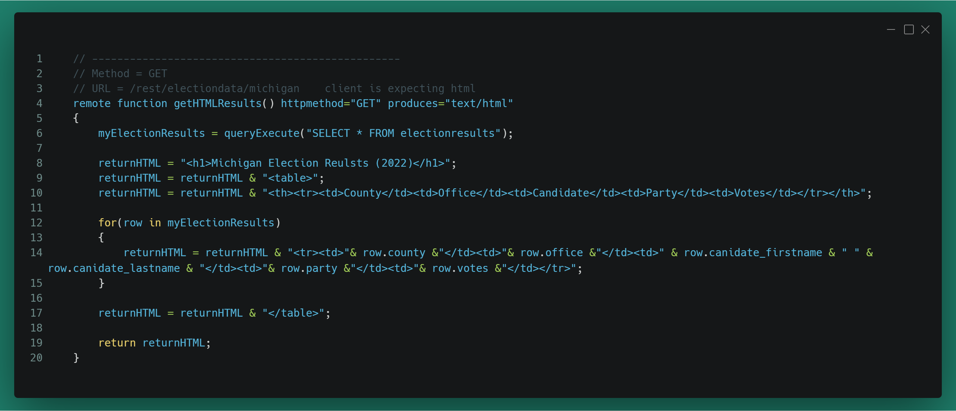
REST Endpoints – Requested Data Type
Within the HTTP headers, the client will tell the endpoint what type of data it is expecting.
If nothing is defined on the CFC function, it will default to ‘all data types’ */*
For example, if data is expected to be displayed in the browser, the client may say it wants ‘text/html’ back. If it wants JSON data back, it may define a MIME type of ‘application/json’

Slide 27
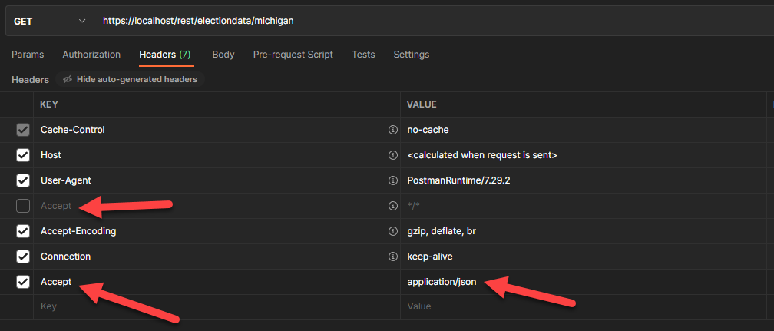
REST Endpoints – Requested Data Type

Slide 28
REST Endpoints – Working with VERBS
One important part of the HTTP call is the VERB. We are used to POST or GET from basic form handling. There are other common ones!
GET, POST, PUT, PATCH, DELETE, COPY
HEAD and OPTIONS also exist, but have special meanings in HTTP
We can override the function calls so that a GET call on a URL does different things than a PUT or DELETE on that same URL.
While METHOD verbs are very common these days, not every firewall/load balancer will allow them. Watch out!

Slide 29
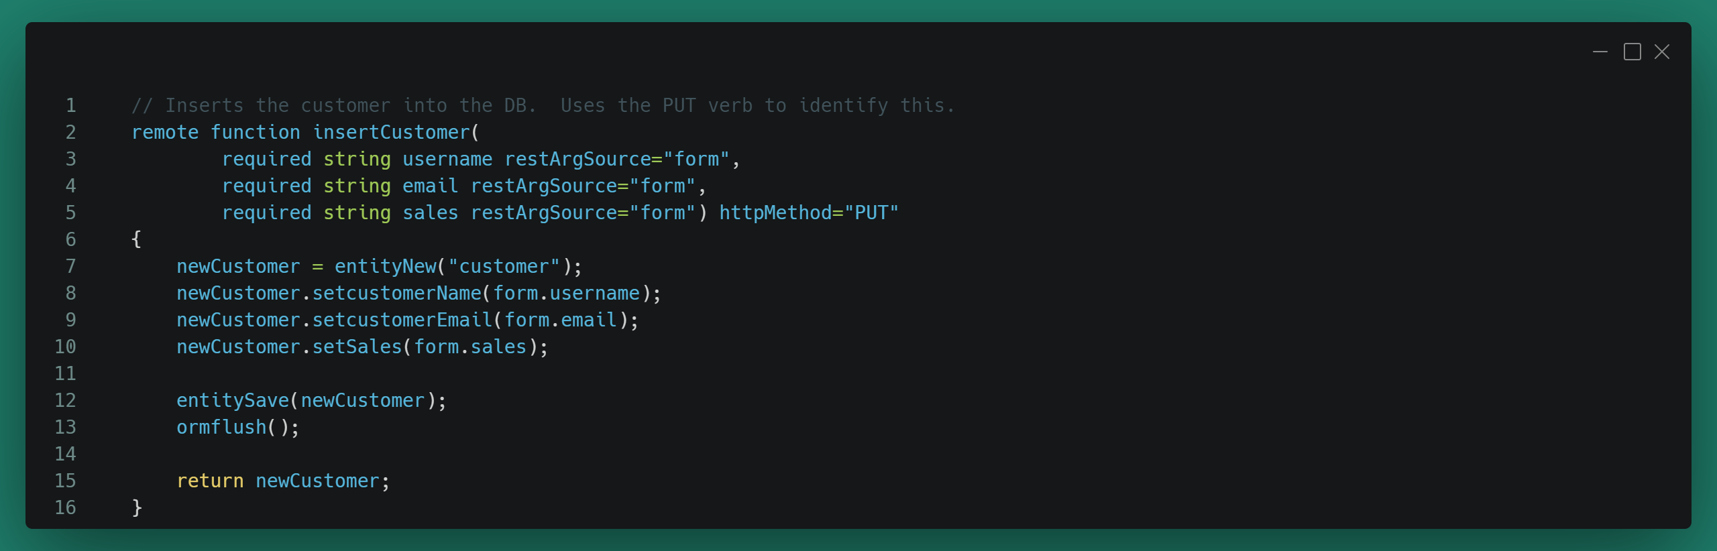
REST Endpoints – Working with VERBS
Let's build a CRUD application. Staring with a CREATE function.
This function takes parameters via the form scope. This requires the app include an encoded FORM in the body of the call.

Slide 30
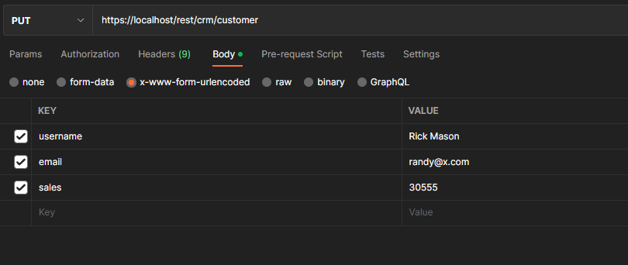
REST Endpoints – Working with VERBS

Slide 31
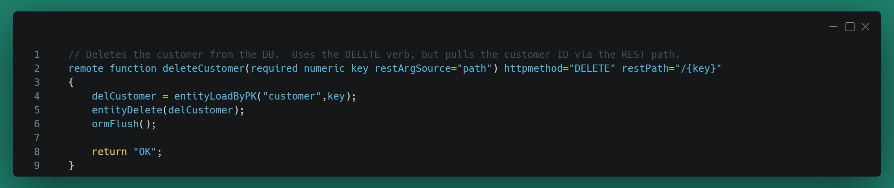
REST Endpoints – Working with VERBS
Very similar for DELETE functions. Set the httpmethod to DELETE
Note that the restPath is the same as the PUT.

Slide 32
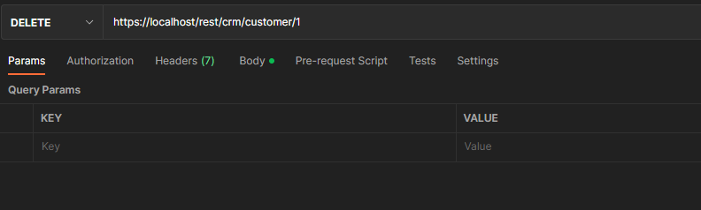
REST Endpoints – Working with VERBS

Slide 33
REST Endpoints - Authentication
Authentication isn’t built in to the ACF/Lucee REST manager… BUT that doesn't mean you can’t do it by hand.
You can control calls to your REST endpoints via the application.cfc, like any other page.
You can build your own “auth token” system where a user checks out that auth token using your site and you check that using the header
You can use the oauth/authN functions in CF to authenticate a user’s client
Good example of using JWT’s here : https://medium.com/analytics-vidhya/building-an-awesome-restful-apis-with-coldfusion-86422f6b2b6f

Slide 34
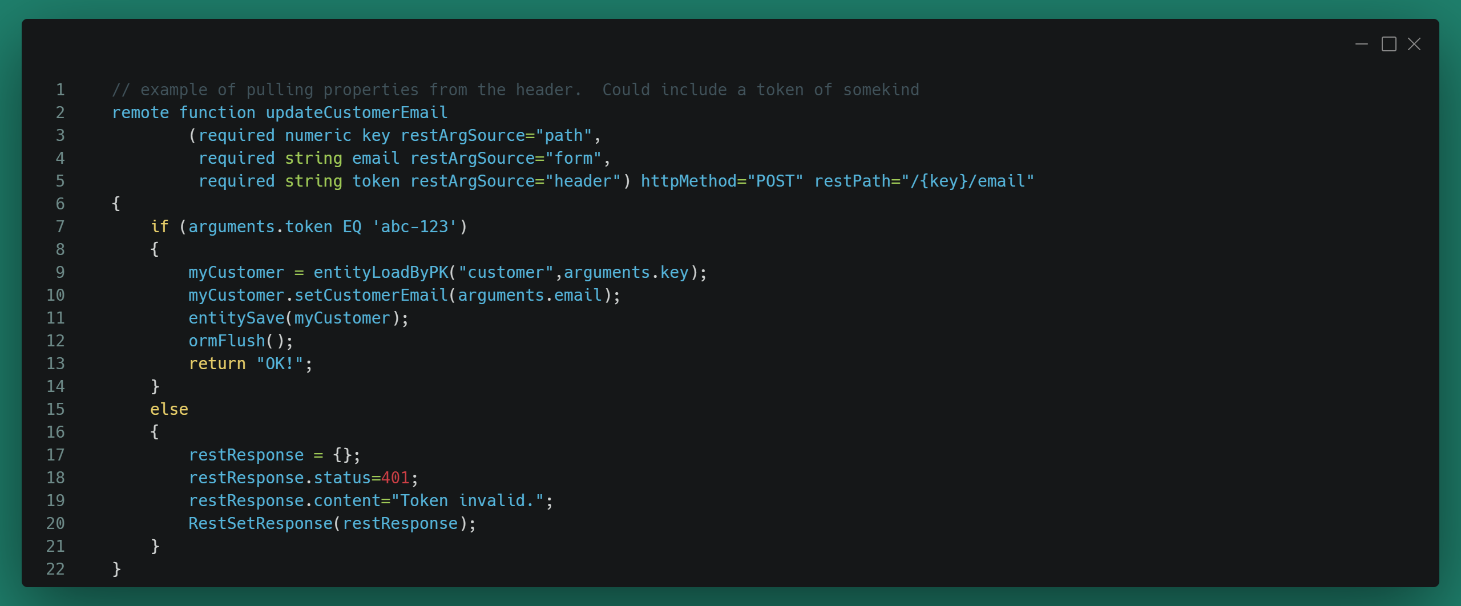
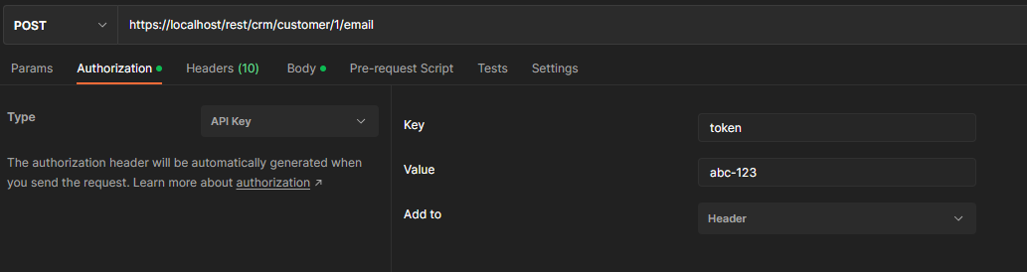
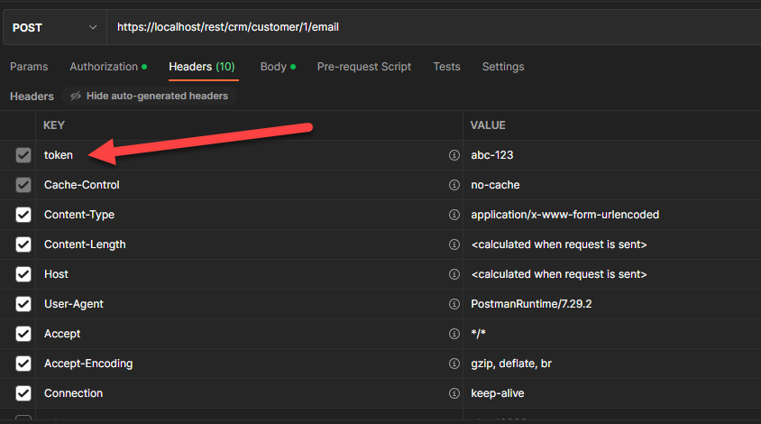
REST Endpoints - Authentication

Slide 35
Q&A

